Slide 1




Chapter #10
Why Bitcoin?
10.0 Intro - Why Bitcoin?
Activity: What could a Bitcoin future look like?
10.1 What are Central Bank Digital Currencies (CBDCs), and who controls them?
10.2 The Philosophy of Bitcoin
Activity: Class Discussion — Do you have the right to control your own money?
10.3 The Benefits of Bitcoin
10.4 An Empowered Future
Activity: Class Discussion — How did your perspective change?
Student Workbook
English Version | 2025

Slide 2




Why Bitcoin?
Chapter #10
10.0 Introduction
Bitcoin is more than a currency; it's a revolution restoring power to the people, offering a taste of peace and freedom in a world hungry for empowerment.
My First Bitcoin
Activity - Watch the Video
The possibilities for positive change are immense, which is why we invite you to watch this video to learn more.
In this concluding chapter, we'll summarize the lessons learned throughout our journey, ask and discuss a few important questions, and explore the future of Bitcoin.
Bitcoin is not just a technology, it’s a type of network which powers a new form of money whose supply cannot be changed by any single party. Humanity has never had a form of money with a fixed supply and no centralized control. If widely adopted, Bitcoin is a tool that will unlock a movement for positive change that can transform the lives of people all over the world. It represents a peaceful revolution towards collective freedom and equity, opening up new opportunities for humanity by creating a shared global monetary system.
As a decentralized global system, Bitcoin enables greater financial freedom, shifting power from the few to the many. It provides a secure, censorship-resistant platform for storing and transferring value, empowering individuals to take control of their wealth and protect their purchasing power. This is especially important in today’s uncertain economic climate, where the traditional financial system is facing unprecedented challenges.
Next, we’ll look at another form of digital currency called a Central Bank Digital
Currency (CBDC), and evaluate how is similar and different to Bitcoin.
10.1 What are Central Bank Digital Currencies (CBDCs) and Who Controls Them?
Central Bank Digital Currencies, or CBDCs, are digital versions of regular fiat money. CBDCs follow the same rules as regular fiat money, where a central authority, like the government, can create more supply thereby reducing people’s purchasing power. However, CBDCs also grant governments new and potent tools to control how that money is used by people around the world.
According to the Human Rights Foundation (HRF) research, 119 out of 193 governments worldwide are looking into, testing, or using CBDCs.
88

Slide 3



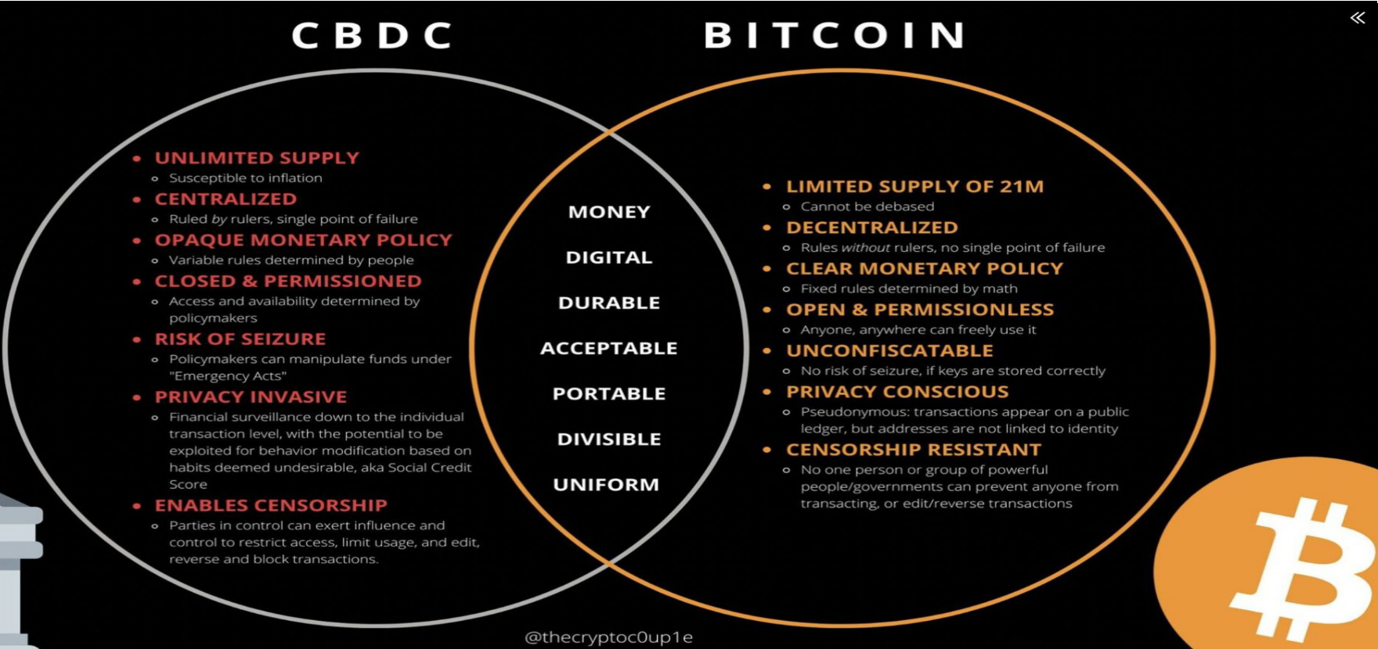
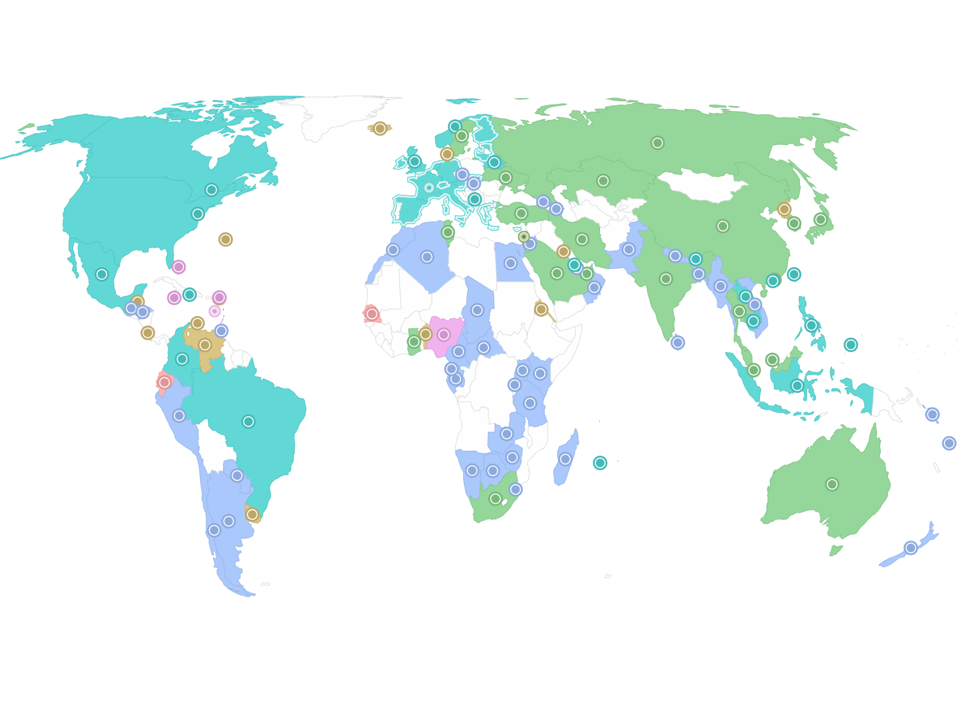
Why Bitcoin?
Chapter #10
You can check if your country is trying CBDCs on the Human Rights Foundation’s CBDC tracker at https://cbdctracker.hrf.org/home or https://cbdctracker.org/
So, what makes CBDCs different from regular fiat money besides being digital? It's crucial to understand that, unlike regular fiat money in the form of paper or coins, CBDCs let the government digitally watch and control every transaction globally. This means the government can stop certain transactions or even freeze your whole account if they don't like you or how you're using your money.
For example, imagine you want to send money to a family member in a country that needs help but your local government rejects your transaction because they don’t agree with that country's leaders. Or picture going to the store to buy something you like but you can't because you expressed your opinion on social media.
CBDCs give governments unlimited power to control how money is used around the world, limiting individuals' ability to spend money based on their own choices. Some even argue that CBDCs would enable powerful governments to centrally enforce tyrannical policies on a global scale at the flick of a switch, without the need for human enforcement agents. Both CBDCs and Bitcoin are digital, but beyond this commonality, they represent very different forms of money with distinct philosophies, leading to varied outcomes for humanity.
10.2 The Philosophy of Bitcoin
In Chapters 6 and 9, we discovered that individuals who run a node help keep Bitcoin's rules safe. This is a big deal because, for the first time ever, people like us can be part of a team that ensures the rules of our monetary system are protected. These rules include the fact that there's only a limited amount of money, and no one single party can change these rules. It's a unique opportunity for regular people to
help keep our money secure and reliable.
89

Slide 4














Why Bitcoin?
Chapter #10
Bitcoin's philosophy is about empowerment, freedom, financial independence, critical thinking, and the concept that we should all have a say in the rules of the system we choose for ourselves. Unlike the fiat system controlled by powerful central parties, Bitcoin works on a network where no single party has all the control. This means, unlike with other types of money, like CBDCs, nobody can take your property from you or stop you from spending your money the way you want.
In the fiat world, having more wealth directly translates to having more influence and control. Contrastingly, Bitcoin operates in a way that's all about power to the people. It's a team effort where everyone, no matter how much money they have, plays a crucial role in the system. Imagine it as a collective force, where your financial size doesn't automatically mean you control everything. Bitcoin is built on unchangeable rules, and, in this harmony, it's as if humanity itself is in control of the system. It's not a few big shots calling the shots; it's all of us working together, as a resilient community, guiding the course of Bitcoin without any single authority telling it what to do.
While in the fiat system the powerful dictate the rules, in the Bitcoin ecosystem, it's the collective strength of individuals that sustains the network. No single entity, regardless of wealth, can dictate the path of the Bitcoin ecosystem. It's an inversion of the traditional power dynamic, where the system’s resilience lies not in the hands of the few, but in the collective power of every participant.
The main idea is to create a safe, clear, and fair system where everyone can access global money equally.
Activity: Class Discussion — Do You Have the Right to Con- trol Your Own Money?
Is money a human necessity and a human right? And why?
If you can’t spend your money how you want, send it to who you want, or take your money with you to a new country, is it really yours? And why?
Why did barter stop being used? What is the problem with the double coincidence of wants?
What historical event was the most impactful for you? Why is it important to understand the Nixon shock and its relevance for everyone today?
How is money with a fixed supply different from traditional fiat currencies?
When was Bitcoin created, by whom, for what purpose, and how does this
purpose define the concept of a decentralized system?
What is the difference between a custodial and a non-custodial wallet? What
was your favorite wallet?
What do you understand about the Lightning Network? What type of transactions would you use it for?
Why does running your own node support the network?
How does having control over your own money empower you in your daily life and future planning?
In what ways can financial freedom enhance your ability to contribute
positively to your community or society?
1
2
3
4
5
6
7
8
9
10
11

Slide 5







Why Bitcoin?
Chapter #10
10.3 The Benefits of Bitcoin
”Hyperbitcoinization” is a theoretical future where Bitcoin becomes the dominant global monetary system. This would mean that bitcoin would be used by everyone, everywhere, and for everything — from buying coffee to paying bills and even buying property.
The growing interest in Bitcoin among individuals, businesses, countries, and governments highlights the potential impact of its widespread adoption on the economy and society. Here are some of the benefits of a hyper-bitcoinized world:
Enhanced Transparency and Traceability:
4The tamper-proof and immutable record of all transactions on the blockchain could increase transparency and accountability in various industries and sectors. Currently, powerful entities have the ability to move trillions of dollars around the world without clear visibility into where these funds go or how they are utilized. By providing an open and verifiable record of financial transactions, Bitcoin could ensure that the movement of capital becomes more accountable and accessible to the public.Enhanced Transparency and Traceability:
A Revolution in the Remittance Market:
The remittance market involves the transfer of funds from one party to another, often across international borders. Despite declining costs, remittances remain relatively expensive compared to domestic bank transfers, especially for smaller amounts. The Lightning Network offers fast and inexpensive transactions, making it well-suited for the remittance market and addressing the high costs and other challenges associated with remittances, such as slow settlement times and restrictions on business hours.
Abundant Energy:
When there's a lot of affordable energy, societies do well, and many industries and communities can meet the increasing need for power in homes, businesses, and new technologies. Bitcoin mining incentivizes miners to use surplus energy which would usually go to waste from sustainable energy sources like solar, wind, and hydroelectric power. Bitcoin Miners use this surplus energy to create new bitcoin through mining activities, secure the network, and offer excess energy they create back to the energy grid society uses when it is needed.
4
A Self-Sovereign Future:
A self-sovereign future is one where individuals worldwide have full control over their own digital identity and assets. This could lead to greater financial inclusion, freedom, privacy, security, and thereby contributing to heightened human flourishing, abundance, and overall happiness.
A Reliable Store of Value:
Bitcoin’s digital scarcity makes it a reliable store of value, which could encourage more people to use it as a means of saving for the future
Changes in Monetary Policy:
If Bitcoin were to become widely adopted, it could take away government’s ability to control the money supply through traditional monetary policy tools. Mass adoption of Bitcoin would potentially increase people’s purchasing power and encourage society to move towards low-time preference activities.
5
1
2
6
3

Slide 6


Why Bitcoin?
Chapter #10
10.4 An Empowered Future
Activity: Final Class Discussion — How Did Your Perspective Change?
Please answer the five questions below:
Bitcoin is money.
Money helps people communicate which activities, goods and services are most important within society. As we have seen in this course, when money is controlled by centralized authorities, it will be manipulated.
One of the mistakes humanity keeps repeating throughout history is manipulating money, which then negatively affects individuals, families, businesses, governments, and ultimately global human prosperity.
By taking control of money out of the hands of centralized parties, and instead using money with a fixed supply that no single party can change, we create a different world — one where we don’t have to trust that man will do the right thing, but rather one in which people is unable to do the wrong thing.
This is a fundamentally different world.
And you, dear student, can be a part of creating this world. By using Bitcoin, running your own node, and helping your fellow humans learn more about the future of money, you are voting for a different world.
Why do we need money?

Slide 7


Why Bitcoin?
Chapter #10
What is money?
What gives money its “value”?
Who controls money?
Write down the questions posed by students that were selected during hapter 1 and answer them.

Slide 8







Why Bitcoin?
Chapter #10
1
Go back to the first activity in chapter 1, and compare your new answers
to your old answers.
Discuss the original answers and questions with the class. Did something change?
Ask yourself this final question: What is my next step? And how can I use
this new knowledge to empower myself?
2
3
“If you’re ready to take the next step, check out the next additional resources section, where we have selected the best resources for further learning and success.”

